Slide 1

caGrid Overview
caGrid Roadmap Workshop
Columbus, OH
February 20-21, 2008

Slide 2
Agenda

Slide 3
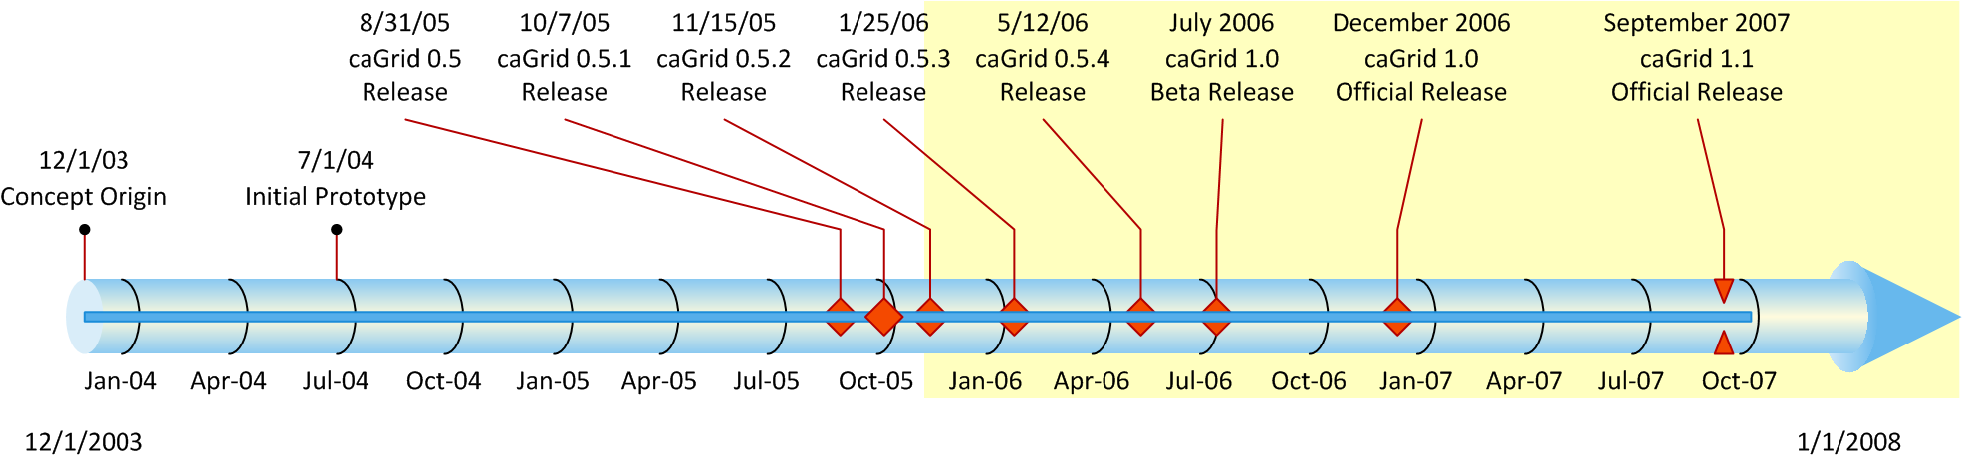
History of caGrid
Developed as the Grid toolkit for caBIG, 2004
caGrid 1.0 was a revolutionary release of the caGrid infrastructure, replacing the 0.5.x test bed stream
The last release of caGrid was version 1.1, released mid September 2007
The next release version 1.2, will be released this quarter
Notes:
3

Slide 4
Driving needs: cancer Biomedical Informatics Grid
A multitude of “legacy” information systems, most of which cannot be readily shared between institutions
An absence of tools to connect different databases
An absence of common data formats
A huge and growing volume of data must be collected, analyzed, and made accessible
Few common vocabularies, making it difficult, if not impossible, to interlink diverse research and clinical results
Difficulty in identifying and accessing available resources
An absence of information infrastructure to share data within an institution, or among different institutions

Slide 5

What is caBIG?
Common, widely distributed infrastructure that permits the cancer research community to focus on innovation
Shared, harmonized set of terminology, data elements, and data models that facilitate information exchange
Collection of interoperable applications developed to common standards
Cancer research data available for mining and integration

Slide 6

What is caGrid?
A grid based software infrastructure consisting of services, toolkits, APIs, and applications
A production grid deployment of the core services provided by that infrastructure
A community of developers leveraging that grid and infrastructure to provide applications and services to the cancer research community

Slide 7

What is caGrid to caBIG?
The “G” in caBIG
Cancer Biomedical Informatics Grid
Provides the software foundation which underlies the tools and applications of caBIG
Analogous to the “power grid”, but without the wires
A multitude of applications with differing requirements can seamlessly be plugged in to a common infrastructure

Slide 8
Infrastructure Focus Areas
Leveraging Grid technologies and standards as an interoperability platform
Metadata Infrastructure
Surfacing wealth of existing caBIG data-oriented metadata on the grid
Providing new service-oriented metadata
Security
Integrating existing systems and applications with Grid security
Lowering burden of implementation of grid-wide and local policy
Service Developer Tooling
Powerful platform for bringing applications and data to the grid
Facilitating Grid wide operations
Federated query, workflow execution, resource discovery
Making the Grid more accessible
Graphical installation and configuration, higher-level object-oriented APIs, web portals, graphical administrative applications
Quality
Comprehensive testing infrastructure, automated builds and test execution on multiple platforms, dashboard with historical archive

Slide 9
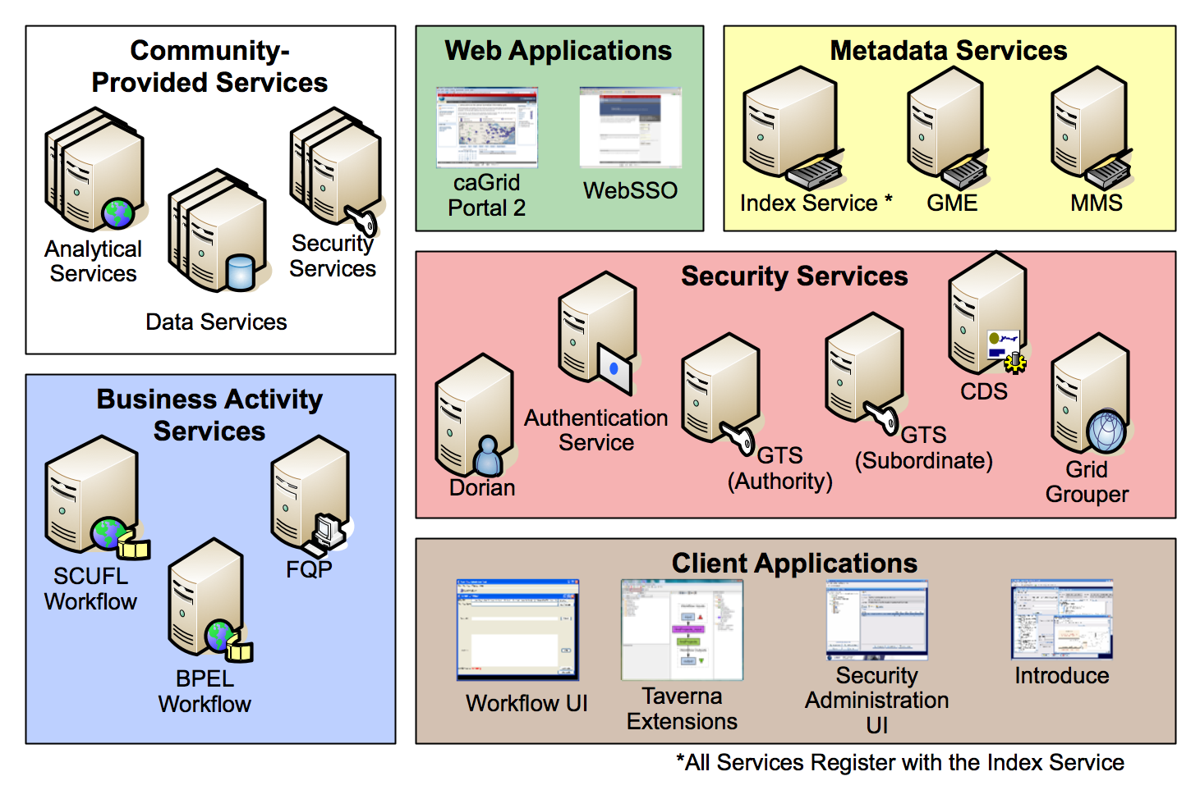
caGrid Production Environment

Slide 10
caGrid Community Involvement
caGrid itself provides no real “data” or “analysis” to caBIG™; its the enabling infrastructure which allows the community to do so
Community members add value to the grid as applications, services, and processes (for example: shared workflows)
caGrid provides the necessary core services, APIs, and tooling
The real “value” of the grid comes from bringing this information to the “end user”
Community members develop end user applications which consume of the resources provided by the grid

Slide 11
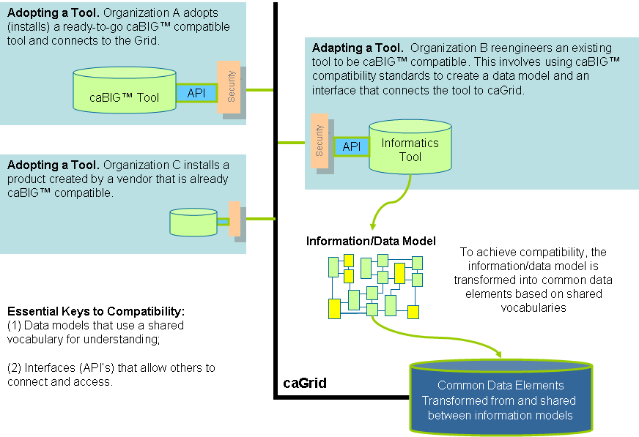
A Summary Conceptual View: How It All Fits Together

Slide 12
Service Layers

Slide 13
Service Layers: caBIO Data Service example
Introduce-managed Security constraints
GTS-managed Trusted Authorities
CSM/Grid Grouper Authorization
Common Data Service Operations (WSDL)
CQL, CQLResult, Data Service Faults (XSD)
caBIO Schemas (XSD)
caGrid Metadata Schemas (XSD)
WS-Enumeration Operations and Types (WSDL, XSD)
Introduce-generated ServiceMetadata
Introduce-generated DomainModel
Introduce-provided common operation implementations (Resource Property, Security Metadata)
caGrid-provided CQL implementation to query ApplicationService
Introduce managed configuration points:
Index Service Location
Data Service Component Implementations (CQL Processor, Validators)
ApplicationService Information
Other options
Introduce-generated code to manage service group registration and maintenance
Introduce-generated Resource to manage metadata
Introduce-generated Resources to manage enumerations

Slide 16
Metadata Services
Cancer Data Standards Repository (caDSR)
caBIG projects register their data models as Common Data Elements (CDEs) which are semantically harmonized and then centrally stored and managed the caDSR
The caDSR grid service provides:
Model discovery and traversal
caGrid standard metadata generation capabilities
Enterprise Vocabulary Services (EVS)
EVS is set of services and resources that address the need for controlled vocabulary
The EVS grid service provides:
Query access to the data semantics and controlled vocabulary managed by the EVS
Global Model Exchange (GME)
GME is a DNS-like data definition registry and exchange service that is responsible for storing and linking together data models in the form of XML schema.
The GME grid service provides:
Access to the authoritative structural representation of data types on the grid
Globus Information Services: Index Service
The Globus Information Services infrastructure provides a generic framework for aggregation of service metadata, a registry of running Grid services, and a dynamic data-generating and indexing node, suitable for use in a hierarchy or federation of services
The Index grid service provides:
Yellow and white pages for the grid

Slide 17
caGrid Data Description Infrastructure
Client and service APIs are object oriented, and operate over well-defined and curated data types
Objects are defined in UML and converted into ISO/IEC 11179 Administered Components, which are in turn registered in the Cancer Data Standards Repository (caDSR)
Object definitions draw from controlled terminology and vocabulary registered in the Enterprise Vocabulary Services (EVS), and their relationships are thus semantically described
XML serialization of objects adhere to XML schemas registered in the Global Model Exchange (GME)

Slide 18
caGrid Standard Service Metadata
All caGrid Services are expected to publish a set of standard metadata which draws heavily from the metadata registered in caDSR and EVS
Common Metadata describes generic information about service providing Cancer Center, points of contact, etc
The Service’s operations are defined and their inputs and outputs link to Classes in caDSR and semantics from EVS
Data Services additionally describe the domain Model they are exposing
Associations between classes
Semantics of the model itself

Slide 19
caGrid Advertisement and Discovery
All services register their service address and metadata information to an Index Service
The Index Service subscribes to the standardized metadata and aggregates its contents
Clients can discover services using a discovery API which facilitates query and inspection of metadata
Leveraging semantic information in EVS (from which service metadata is drawn), services can be discovered by the semantics of their data types

Slide 20
Data Service Overview
caGrid Data Services provide capability to expose data resources to the Grid
Specialization of caGrid grid services to expose data through a common query interface
Meet all base service requirements of caGrid services
Present an object view of data sources
Exposed objects are registered in caDSR and their XML representation in GME
Data Service Metadata describes information model
Queries made with CQL Query objects
Results returned as objects nested in a CQL Query Result Set
Graphical Development tool, implemented as an extension to the Introduce Toolkit, is used to create the new grid service

Slide 21
Data Service Query Language
Simple, “minimum entry” for data providers
Specifies a target object (result) type and selects the instances which satisfy the specified properties and nested object properties
Allows path navigation
Provides logical grouping
Provides name/predicate/value filtering on properties of objects
Recursively defined
Ability to return full Objects, Set of attributes, count of results, or distinct attribute values

Slide 22
Federated Query Processor
Provides a mechanism to perform basic distributed aggregations and joins of queries over multiple data services
As caGrid data services all use a uniform query language, CQL, the Federated Query Infrastructure can be used to express queries over any combination of caGrid data services
Federated queries are expressed with a query language, DCQL, which is an extension to CQL to express such concepts as joins, aggregations, and target services
Implemented as a stateful grid service, queries may be executed asynchronously and results retrieved at a later time
Supports secure deployments wherein result ownership is enforced
Coupled with semantic discovery capabilities of caGrid, provides a powerful framework for data discovery, mining, and integration

Slide 23
Workflow Service
Provides capability to describe “orchestrations” of service invocations and data movement
Uses existing defacto standard language: Business Process Execution Language (BPEL)
Interoperability with other clients, editors, engines
Implemented as a stateful grid service, workflows can be created, stopped, paused, resumed, and cancelled and results retrieved at a later time
Coupled with semantic discovery, service metadata, and registration of data type structures in caGrid, provides a powerful framework for analyzing data
Services can be dynamically discovered and federated queries can be invoked as part of a workflow

Slide 24

Introduce Vision
Become the one stop shop for grid service development
Provide a simple, yet powerful, graphical user interface (GUI) to encapsulate complexities of grid service development
Provide an extensible toolkit with which grid services can be created and modified programmatically

Slide 25
Introduce Overview
A framework which enables fast and easy creation of Globus based grid services
Provide easy to use graphical service authoring tool.
Hide all “grid-ness” from the developer
Utilize best practice layered grid service architecture
Integration with other core grid services and architecture components
GAARDS Security Infrastructure (Dorian, GridGrouper, CSM)
Globus Index Service
Global Model Exchange (GME)
Cancer Data Standards Repository
Extension Framework for integrating with other architecture components

Slide 26
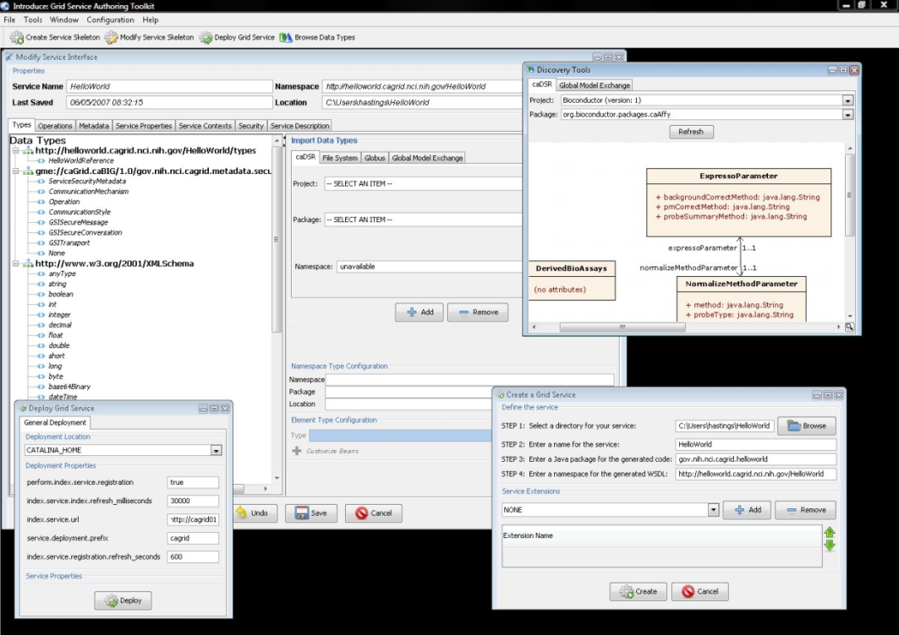
Introduce Features
Supports modification of operations
Adding operations
Removing Operations
Updating Operations
Importing Operations
Graphical Configuration
Advertisement
Security
Service Metadata Specification
Service Metadata Editing
Service Configuration Properties
Auto Generates Code for Service
Auto generates a client API for service.
Graphical Deployment of Service
Globus
Tomcat
JBoss

Slide 27
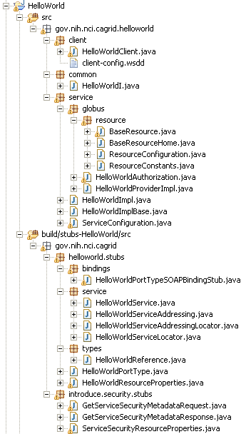
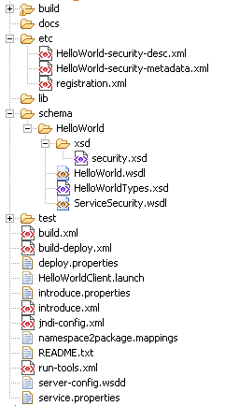
Created Skeleton Layout
= introduce managed
= globus/axis managed
= developer implements

Slide 28




An example service development process (0 lines of developer code)
Create Semantically Harmonized Data Model
Generate
Data Resource
Grid-ify

Slide 29
Pre-grid
A caCORE SDK generated data resource which is not connected to the grid.
Grid
caBIO

Slide 30

Exposing the Resource:
We will use the Introduce data service wizard to describe our data resource and generate a grid service.
Grid
caBIO

Slide 31
Exposing the Resource:
Introduce will enable the user to browse data model in the caDSR and chose the ones which they are going to be exposing.
GME
Grid
CQL query
processor
caBIO

Slide 32

Exposing the Resource:
Then they will locate the schemas which describe the data models and will provide the wire protocol for transferring data instances.
GME
Grid
CQL query
processor
caBIO

Slide 33

Exposing the Resource:
Lastly the user will have to provide a CQL query processor to enable CQL query to be executed against the data resource.
GME
Grid
CQL query
processor
caBIO

Slide 34
Exposing the Resource:
Introduce will create a grid service which can expose the data resource we described to the grid
Grid
caGrid
Data Service
caCORE CQL query
processor
caBIO

Slide 35
Data now available.
Now that our service is generated we can deploy it so that the resource can be used.
Grid
GridService
caBIO
Grid Service
caGrid
Data Service
caCore CQL query
processor
caBIO

Slide 36
How will users find me
We need to expose metadata to a registry so that a user/service can locate and use our service
Grid
GridService
caBIO
Grid Service
caGrid
Data Service
caCore CQL query
processor
caBIO

Slide 37
How will users find me
We will send our metadata to an index service that can be queried by grid users.
Grid
GridService
caBIO
Grid Service
caGrid
Data Service
caCore CQL query
processor
caBIO
Index Service

Slide 38
GAARDS Overview
Grid Authentication and Authorization with Reliably Distributed Services (GAARDS)
GAARDS provides services and tools for the administration and enforcement of security policy in an enterprise Grid.
Developed on top of the Globus Toolkit
Extends the Grid Security Infrastructure (GSI)
Provide enterprise services and administrative tools for:
Grid User Management
Identity Federation
Trust management
Group/VO management
Access Control Policy management and enforcement
Integration between existing security domains and the grid security domain
Delegation
Web Application integration

Slide 39
GAARDS Components
Dorian
Grid User and Host Account Management
Integration point between external security domains and the grid
Allows accounts managed in external domains to be federated and managed in the grid
Dorian allows users to use their existing credentials (external to the grid) to authenticate to the grid
Grid Trust Service (GTS)
Creation and Management of a federated trust fabric
Supports applications and services in deciding whether or not signers of digital credentials/user attributes can be trusted
Supports the provisioning of trusted certificate authorities and corresponding CRLS
Grid Grouper
Group management service for the grid
Provides a group-based authorization solution for the Grid
Enforce authorization policy based on membership to groups

Slide 40
GAARDS Components cont.
Authentication Service
Integrates existing credentials providers into the grid
Provides a uniform grid interface for authenticating to existing credential providers
Applications can communicate with any credential provider
Credential Delegation Service (CDS)
Enables users/services (delegator) to delegate their Grid credentials to other users/services (delegatee) such that the delegatee(s) may act on the delegator's behalf
Extendible delegation policies
Auditing support
Web Single Sign-On (WebSSO)
Provide “Single Sign-On” capabilities for web applications which interact with the grid
Leverage grid credentials for authentication
Allows web applications to invoke grid services on the user’s behalf

Slide 41
GAARDS Components cont.
Common Security Module (CSM)
Provides a centralize approach to managing and enforcing access control policy authorization
Security Metadata
Ensures communication interoperability between grid services

Slide 42
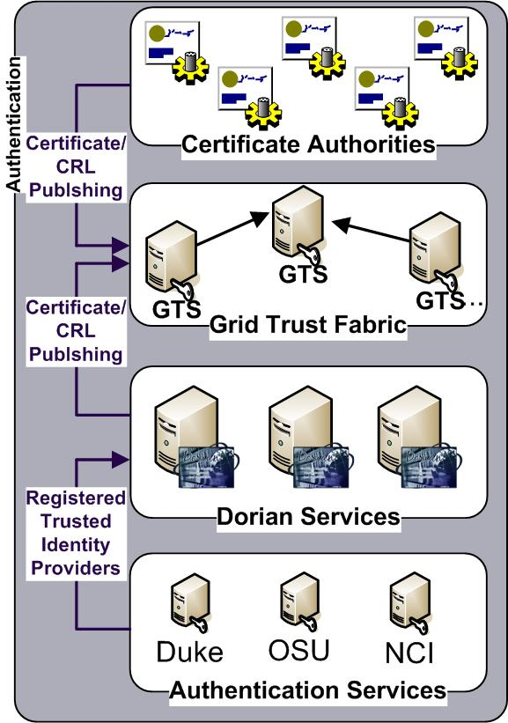
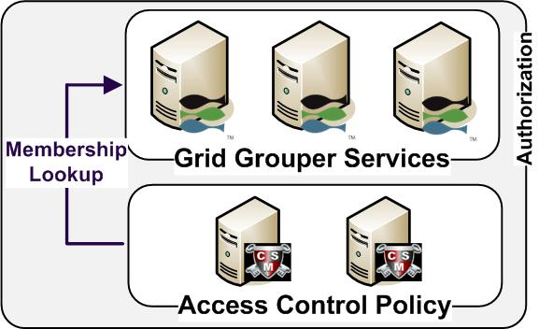
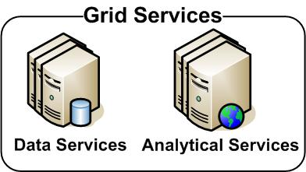
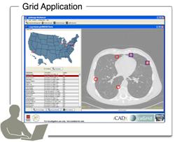
GAARDS in Action

Slide 43
GAARDS in Action
Authenticate with
Local Credential Provider
User authenticates to local credential provider using your everyday user credentials
SAML Assertion

Slide 44
GAARDS in Action
SAML Assertion
Application obtains grid credentials from Dorian using SAML provided by the local provider.
Grid
Credentials

Slide 45
GAARDS in Action
Application uses grid credentials to invoke secure grid services.
Grid
Credentials

Slide 46
GAARDS in Action
Should I trust the
credential signer?
Grid Service authenticates the user by asking the GTS whether or not the signer of the credential should be trusted.

Slide 47
GAARDS in Action
Authorization
Grid Service asks CSM or their access control policy enforcer whether or not the user can perform X and resource Y.
Is
Authorized?

Slide 48
GAARDS in Action
Is member of?
Authorization
Alternative
Grid Service can enforce local policy based on user membership to groups maintained in Grid Grouper.

Slide 49
caGrid Quality
Testing
Unit, System, Integration, and Validation
Automated Builds/Tests on multiple platforms
Nightly (on a schedule)
Continuous (every CVS check in)
Quality Dashboards
DART (multi-site, historical archive of quality)
http://quality.cagrid.org/caGrid-1.0/Dashboard/
CruiseControl

Slide 50
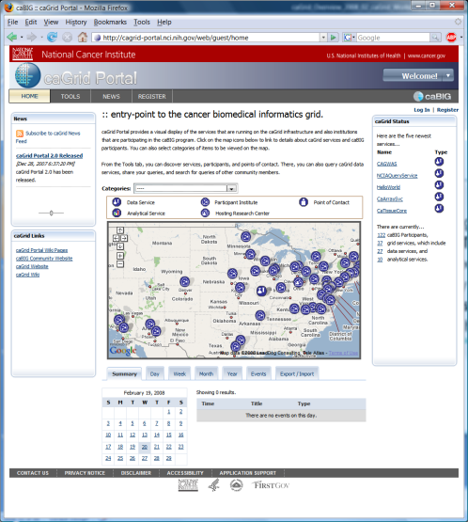
Project Resources and Communication
www.cagrid.org (community wiki)
Download Software
Documentation
Tutorials
Technical Paper and Presentations
FAQs
caGrid GForge Home (project website)
Feature Requests
Bug Reports
Downloads / Source Repository
http://gforge.nci.nih.gov/projects/cagrid-1-0/
caGrid Users Mailing List
https://list.nih.gov/archives/cagrid_users-l.html
cagrid_users-l@list.nih.gov
caGrid Portal (web portal)
http://cagrid-portal.nci.nih.gov/

Slide 51
Backup Slides

Slide 52
Philosophies on Releases
Releases are versioned as <Major>.<Minor>.<Point>
Major versions generally make no claims to backward or forward compatibility; these are used for large new features or significant changes in behavior.
Minor versions generally should be backwards compatible, and may be forward compatible; these are used for significant bug fixes and feature additions.
Point versions should be both backwards and forwards compatible; these are used almost exclusively for bug fixes (one should expect to be able to use the versions interchangeably, with the only difference being related to the behavior of the bugs being addressed).
Currently defining compatibility with respect to service interfaces and client APIs (not for internal APIs or service implementations)

Slide 53
Philosophies on Releases cont.
Major version changes represent an unattractive grid-incompatibility, but are necessary for large changes
caGrid originally released as a single “product”
Starting to look at finer grain organizations:
Creation of separate releases for caGrid Core, Portal, Workflow UI, WebSSO
Milestone release approach used for WebSSO/CDS may be an attractive way to get new features out to early adopters sooner
Developing infrastructure to better enable multi-component, multi-version, dependencies in caGrid (used both internally, as well as for projects which depend on caGrid)

Slide 54
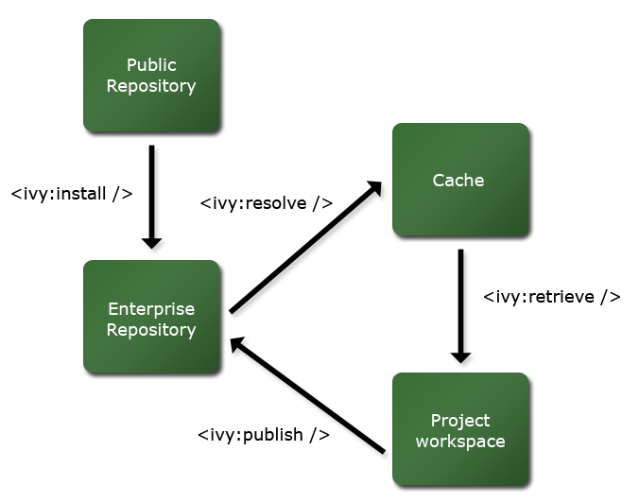
caGrid Ivy Build
caGrid release directory contains an Enterprise Repository for all external dependencies
caGrid build process resolves against this repository, and publishes to an integration repository
Releases will publish the integration repository and Enterprise Repository to a publicly accessible location
External projects/components can depend on a local caGrid integration and Enterprise Repository, or the remote publicly accessible one

Slide 55
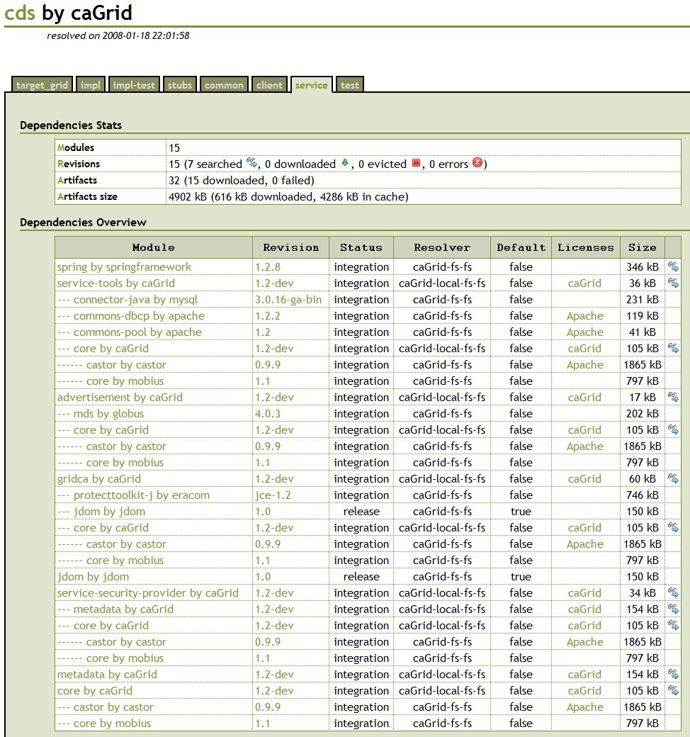
caGrid Ivy Build cont.
Transitive dependencies are formally managed
Supporting multiple configurations and version constraints
Configurable conflict management
Detailed dependencies reports are generated

Slide 56
caGrid Ivy Example Usage
What jars do I need to use the Dorian client API?
Just define the dependency:
<dependency org="caGrid" name=“dorian“ rev=“1.2" conf=“*->client"/>
Tell Ivy where to copy it:
<ivy:retrieve pattern=“lib/[originalname](.[ext])" sync="true" />
Everything you need will be copied where you want it

Slide 58
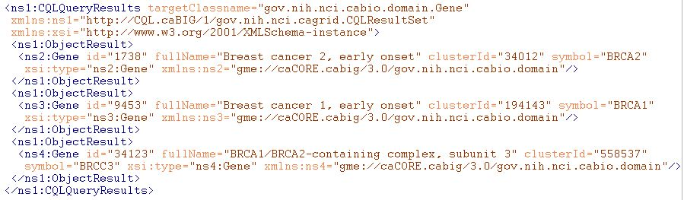
Example of Grid Data Syntax
XML of CQL Results from a query to a Data Service
Infrastructure capable of mapping directly back to corresponding programming language objects
Semantics of data are explicitly bound to the conceptual model (DomainModel) the user queried against, and implicitly associated with this XML via it’s namespace

Slide 59
Example Syntax Use Cases
I’m writing an application to process arbitrary data types, how do I know what the data will look like?
I want to build a grid service, how do I describe the inputs and outputs of its operations?
How can I be sure data I am getting is valid?
I don’t want to work with WSDL or XML, can’t I just use an object-oriented client API to talk to grid services?

Slide 60
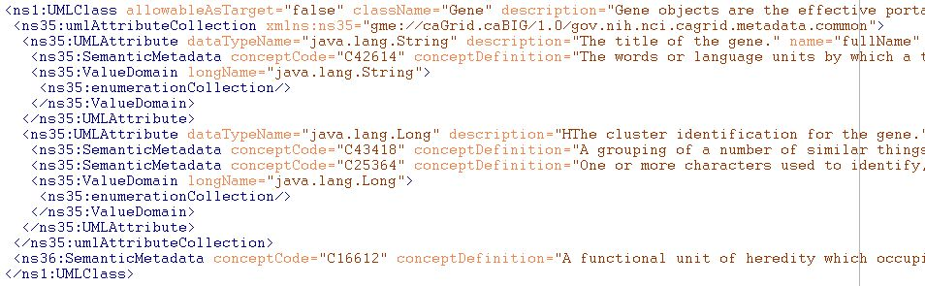
Example of Grid Data Semantics
Snippet of XML representation of DomainModel metadata from a Data Service
Describes the caDSR-registered logical structure, used to query the service; annotated with concept codes from EVS
Independent of the syntax used to realize the data types on the grid (such as in the results of a query)

Slide 61
Example Semantics Use Cases
What are the service addresses of all the running Data Services exposing data based on concept C16612?
What are the permissible values of Taxon.abbreviation in the caBIO 3.1 model?
Are there any Analytical Services on the grid which provide operations over a data type that is semantically interoperable with the caBIO 3.1 Tissue.organ?
How do I learn about the data available from an arbitrary Data Service?

Slide 62
Example Semantic/Syntax Binding Use cases
I’ve received a generic data set (such as a CQL results object), how can I understand the semantics of the contained data?
I want to describe a workflow using either logical models or EVS concepts, how can I figure out how the XML is structured such that I can use BPEL to extract data?
Better yet, is there a graphical tool that can do the transformation for me?
I registered my model in caDSR, why is Introduce asking me for XML Schemas?

Slide 63
Realizing the Binding Use Cases
Need the capability to formally describe, register, and access the association between a given data type’s syntax and semantics
The foundation of the grid data syntax is XML Schema; XML Schemas are identified by their namespaces
The foundation of the grid data semantics are the EVS annotated, caDSR data models; data models are identified by their caDSR identifier and version
The binding between syntax and semantics is essentially a mapping from the UML/caDSR universe to the XML/GME universe

Slide 64
Connecting UML and XML: Current Implementation
Previous “solution” was to require an XML Schema for each package that followed a namespace construction rule
Had several limitations:
Several caBIG projects wish to reuse existing XML Schemas, which have existing namespaces (can’t be changed for interoperability reasons)
Some uniqueness constraints assumed are not strictly enforced
Does not support “reverse lookup” (XSD -> caDSR)
Does not provide fine grain mapping necessary for some applications/infrastructure
Somewhat prescriptive (namespaces, naming conventions, etc) when ideal solution is entirely descriptive

Slide 65
Connecting UML and XML: The complexities
There are a large variety of options on how a conceptual UML model can be represented in XML (many in use within caBIG as well as relevant external XML standards)
Assumptions on namespaces or structure don’t work
Most applications/services “don’t care,” so process must be simple for the default case, but sufficient for the others
Names different
Attribute or element?
What about Collection associations
?

Slide 66
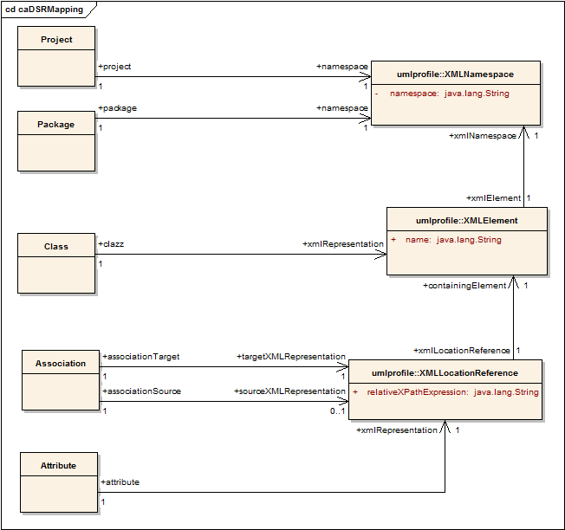
Connecting UML and XML: The solution
Planned definition of mapping rules specify how a given UML entity is represented in XML over the grid
Maintained in the caDSR, lookup and query available through caDSR grid service

Slide 67
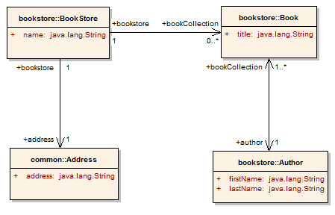
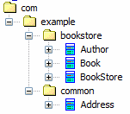
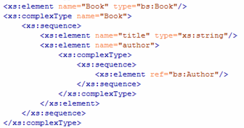
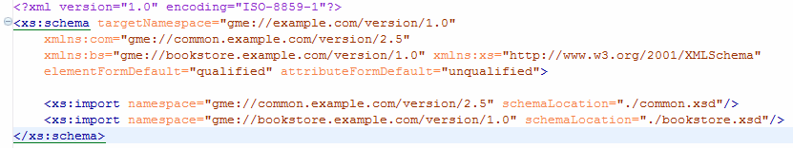
Partial Mapping Example
Project:
BookStore
Version:
1.0
Attribute Mapping
XPath:
title
Element:
Book
Namespace: gme://bookstore.example.com/version/1.0
Project’s Namespace (gme://example.com/version/1.0)

Slide 69
Introduce Requirements
Utilize best practice layered grid service architecture
Enable development of strongly-typed services
discovery and use of published data types
self describing services through use of metadata
advertisement and registration configuration with Index Service
Generate meaningful object-oriented client APIs
Customizable and extensible via the use of plug-ins
Allow for implementation of secure services
provide customizable service-, method-, and resource- level security

Slide 70
Addressing the Requirements: Strongly typed interfaces
Introduce enables schema extraction from a GME or any other data model registry service
WSDL, beans, and service metadata can be automatically populated
Service will be strongly typed with publicly accessible data types
Example from caGrid

Slide 71
Addressing the Requirements: Strongly typed interfaces (cont)
Providing Service Metadata:
Service metadata is provided as resource properties on the base service’s singleton resource
These resource properties are defined by xml schema (also discovered from type repository)

Slide 72
Addressing the Requirements: Strongly typed interfaces (cont)
Index Service Registration
Leverage Globus MDS to register service metadata to an Index Service
Provide configuration options for registration of static and dynamic service metadata which can then be used at runtime for service discovery
Example from caGrid

Slide 73
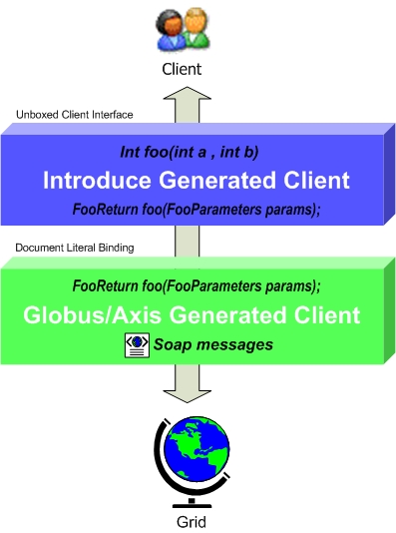
Addressing the Requirements: Object Oriented Client API
Globus/Axis build process will automatically generate a client side object oriented API
Introduce generates a wrapper for this API which matches the service designers interface to make a clean mapping from client to service
Handle auto boxing/unboxing of the parameters into and out of document literal form

Slide 74
Addressing the Requirements: Extensible Architecture
Introduce provides an extension framework where it’s core functionality can be extended to provide customized solutions by leveraging the Introduce toolkit.
There are currently two types of extensions in Introduce
Service
Types Discovery
Extensions provide an “extension.xml” extension description and configuration. The “extensions” directory of introduce hold the extensions in separate folders enabling them to easily be added and removed from the Introduce toolkit.

Slide 75
Addressing the Requirements: Extensible Architecture (cont)
Flow of execution for service extension components.

Slide 76
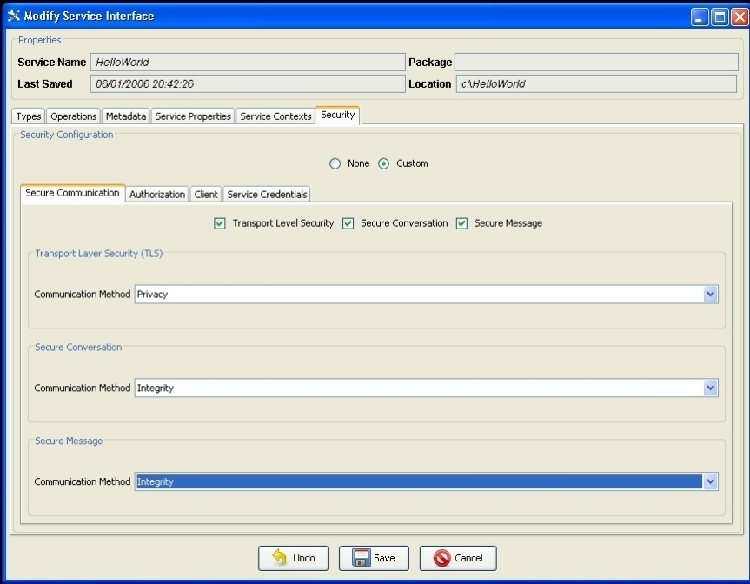
Addressing the Requirements: Security (communication channel)
Grid Services can support multiple communication protocols.
Different methods in a grid service can be configured to use different communication mechanisms.
Configuration of the communication mechanisms can be complex.
Introduce manages this complexity for the user allowing them to configure security graphically.

Slide 77
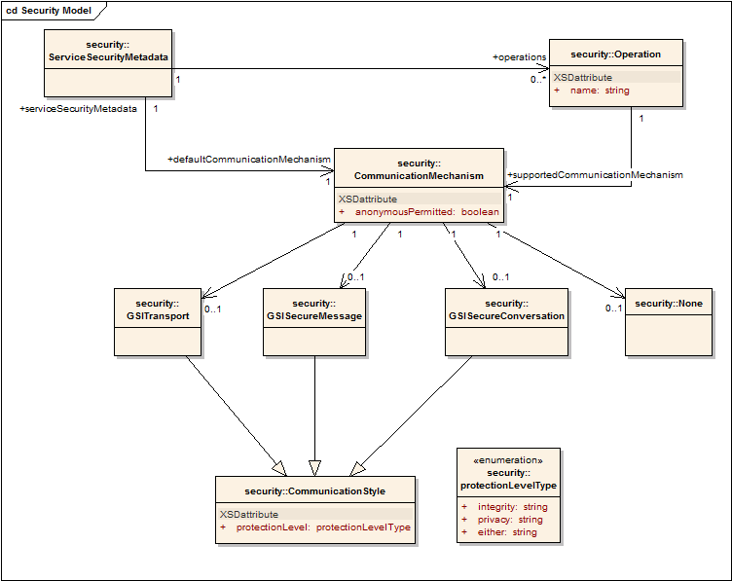
Addressing the Requirements: Security (communication channel cont)
In order to ensure communication interoperability between grid services, grid services need to publish security metadata
All Introduce created services automatically support making Security Metadata available
Introduce clients automatically obtain the security metadata from the service and use it to determine how to communicate with the service

Slide 78
Addressing the Requirements: Security (authorization)
Authorization policy can be specified graphically service wide, or operation specific
Introduce by default will generate the PDP authorization class from the requirements selected by the service creator using GridGrouper and/or CSM
Developer has the choice to use a custom or existing PDP class

Slide 79
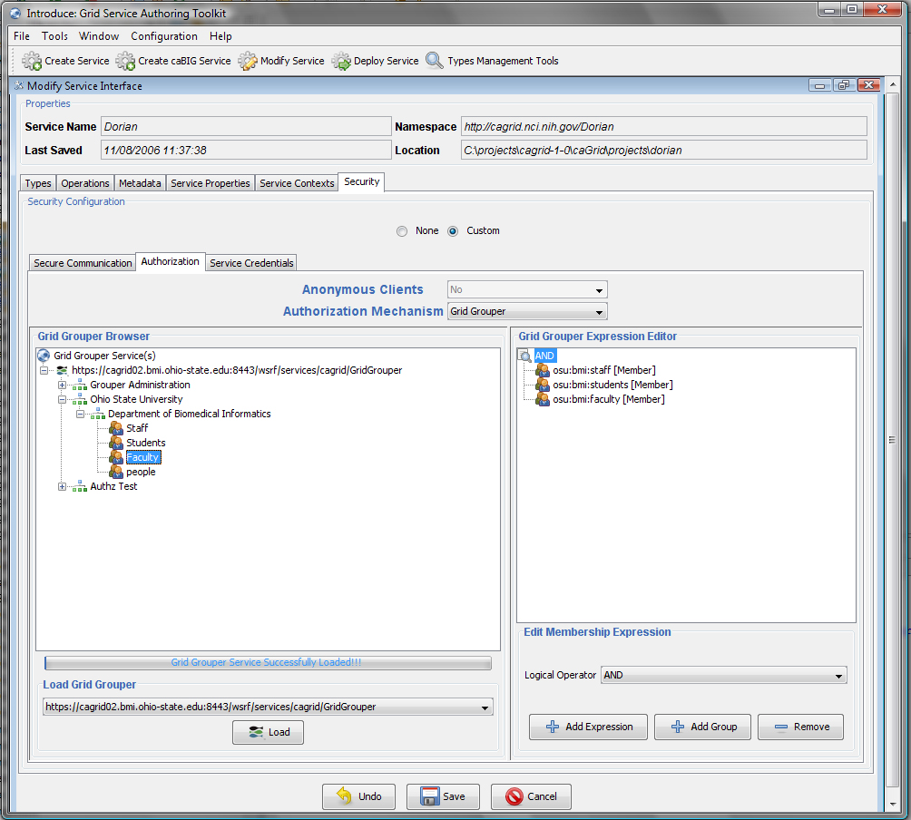
Addressing the Requirements: Security (authorization cont)
Integration with GridGrouper for authorization policy enforcement
Supports both service and operation level authorization
Authorization defined as set theory based membership queries
Queries built interactively through live GridGrouper browser

Slide 80
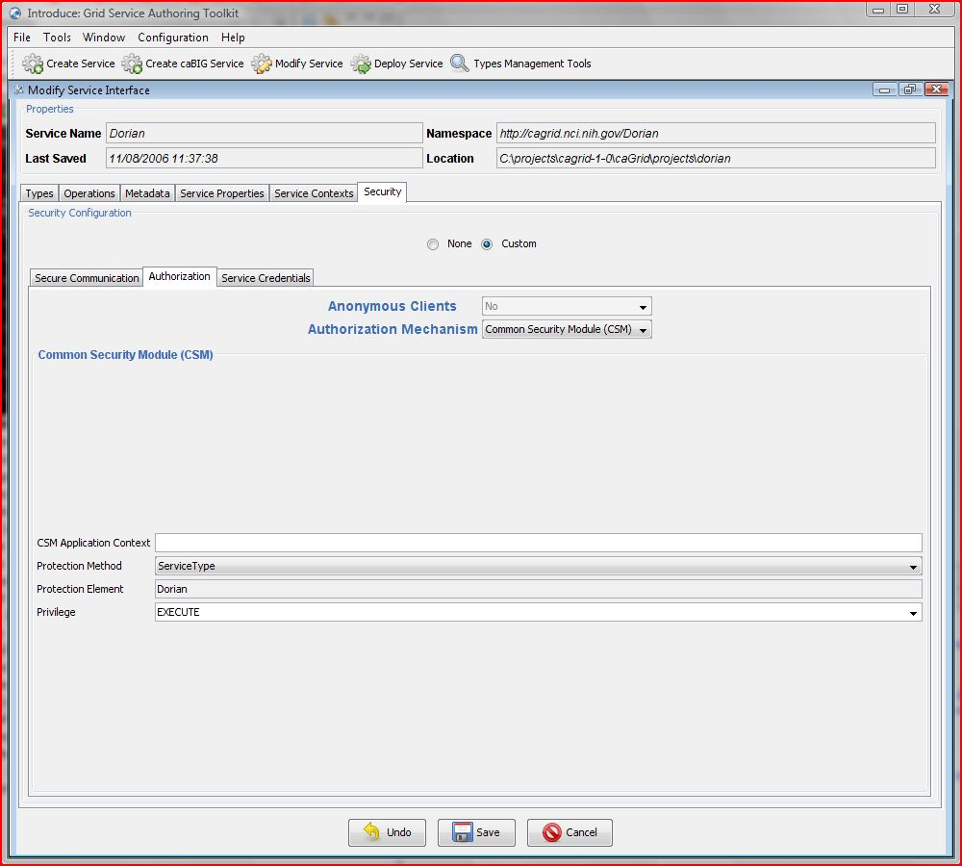
Addressing the Requirements: Security (authorization cont)
Integration with CSM for authorization policy enforcement
Supports both service and operation level authorization
App. Context
Protection Method
Service Type
Service URI
Custom
Protection Element
Privilege
Standard CSM
Notes:
caGrid provides Introduce tooling to support the API-based approach. Introduce will generate the code required to use CSMGridAuthorizationManager in your service. One can choose to enforce authorization at the service and/or operation level.

Slide 81
Addressing the Requirements: Security (example)

Slide 82

caGrid Releases
caGrid 1.3 is a point release of the caGrid 1.x stream. Services and applications developed using caGrid {1.0, 1.1, 1.2}, will function against caGrid 1.3 versions of those services.
Version | Release Date
caGrid 1.3 | 31st March 2009
caGrid 1.2 | 31st March 2008
caGrid 1.1 | 17th September 2007
caGrid 1.0 | 15th December 2006
caGrid 1.0 Beta | 17th July 2006
caGrid 0.5.4 | 12th May 2006
caGrid 0.5.3 | 25th January 2006
caGrid 0.5.2 | 15th November 2005
caGrid 0.5.1 | 7th October 2005
caGrid 0.5 | 31st August 2005

Slide 83
caGrid 1.3 Core Services
All caGrid Core Services were redeployed on all caBIG® Grids
(OSU Training, QA, Stage, and Production) for this release.
The (12) caGrid 1.3 Core Services are:
* New for 1.3 ** Significantly Rewritten or Enhanced for 1.3
Metadata Services | Security Services | Business Activity Services
Global Model Exchange Service** | Authentication Service** | Federated Query Processor Service**
Index Service** | Credential Delegation Service | BPEL Workflow Service
Metadata Model Service* | Dorian Service** | Taverna Workflow Service*
 | Grid Grouper Service
 | Grid Trust Service (Master & Slave)

Slide 84
Deprecated Services
During the development of caGrid 1.3, the caGrid Team issued a request for comments on, and adopted, a Deprecation Policy. For details, see:http://cagrid.org/display/caGrid13/Deprecated+Services+and+APIs
After adoption of that policy, the caGrid 1.2 caDSR, caGrid 1.2 EVS, and caGrid 1.2 GME were retired:
caGrid 1.2 caDSR Service (based on caCORE 3.1)
Replaced by the caDSR 4.0 Data Service and the new caGrid 1.3 Metadata Model Service (MMS)
caGrid 1.2 EVS Service (based on caCORE 3.1)
Superseded by EVS 4.1 Grid Service
caGrid 1.2 GME Service
Replaced by new GME service
These retired services will continue to operate until Q2 2009, when the caCORE 3.1 API is decommissioned.
While still supported in caGrid 1.3, the BDT framework is deprecated

Slide 85
Development Campaigns
The scope for this release came from requests entered into Gforge and feedback received from all the domain workspaces. Those tasks fell into one of seven development campaigns:
caBIG® Gold Compatibility
caCORE SDK Integration
Data Services
Introduce Toolkit
Security
Continuous Innovation
Bug Fixes

Slide 86
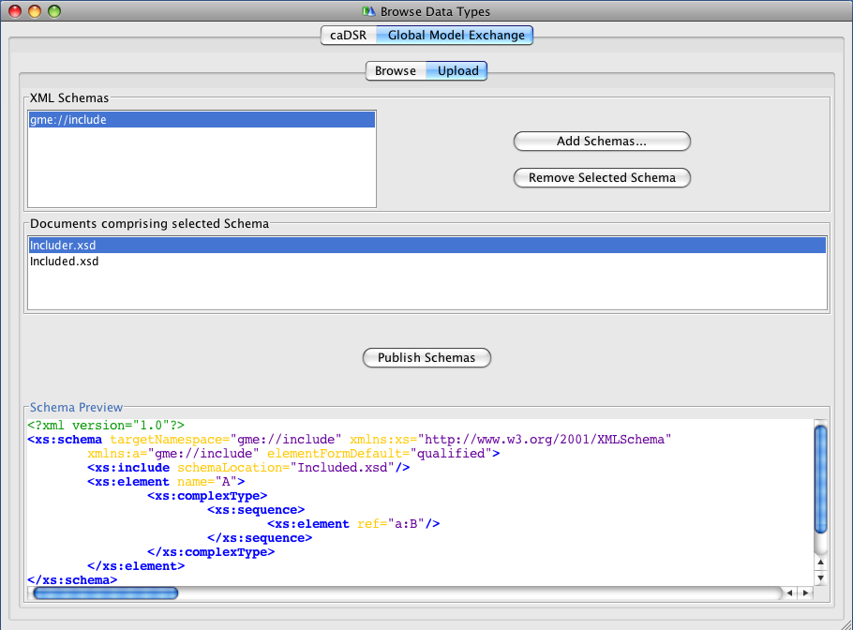
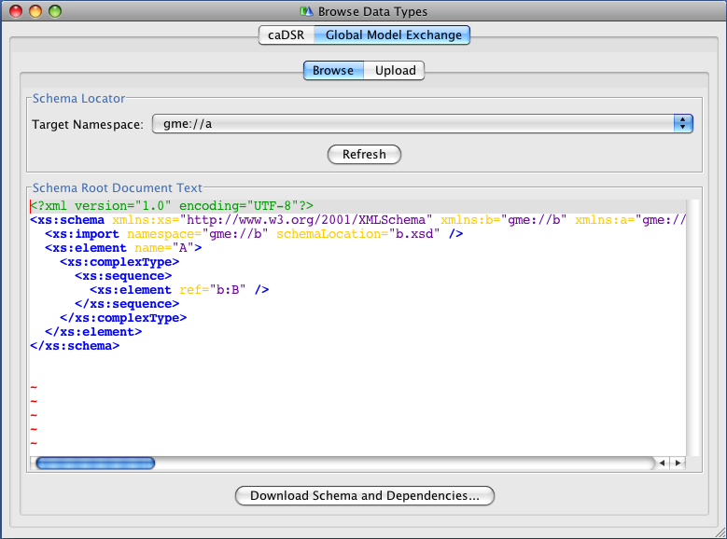
Gold Compatibility: Global Model Exchange (GME)
Completely re-implemented for caGrid 1.3 to address numerous feature requests and limitations
Now a fully managed Introduce service (previously was just a wrapper to the Mobius GME software)
Leverages…
Spring for configuration and data patterns
Hibernate for data persistence
Castor for custom domain model serialization
Xerces for 100% XML Schema support
Improved Introduce integration
Selected new features:
Now supports XML Schemas with includes, redefines, cyclic imports, arbitrary namespaces
Schema Deletion
MySQL 5 support

Slide 87
Gold Compatibility: Metadata Model Service (MMS)
As the caDSR Grid service was retired, its functionality was replaced with the caDSR Data Service and the new MMS
MMS provides the metadata-oriented functionality, such as generating Domain Models and semantically annotating Service Metadata
Simple migration path from caDSR grid service to MMS
Is a generic service which provides the ability to integrate any external metadata registry as a metadata source for annotations
Leverages Spring for deploy-time configuration
Default implementation uses the production caDSR as its source, but (multiple) other registries can be added to the same service
Not dependent on a particular model or software version of the caDSR
Makes full use of the new caDSR XML Schema namespace binding annotations
Fully integrated into Introduce for visualizing Domain Models and annotating metadata instances

Slide 88
Gold Compatibility: Index Service
Working with the Globus MDS team (ISI), the Index Service implementation was completely redesigned for better memory usage and performance
Leverages Apache Xindice XML Database for “out of memory” storage and query (previous version was all Heap-based).
Added multi-threading for metadata polling to greatly increase registration throughput
Slight change in behavior, but 100% backwards compatible to Discovery and Advertisement clients
Production Index Service now running smoothly with 130+ registrations
Local tests scaled up into the thousands
Modified default Introduce-generated advertisement settings to reduce the load on the Index Service while maintaining the same response time

Slide 89
Gold Compatibility: caDSR Model Registration
Registration of models, which Introduce puts in services it creates, in the caDSR (in process):
CQL
CQL Results
Service and Security Metadata
Will allow methods using those models to be properly semantically annotated in the Service Metadata

Slide 90
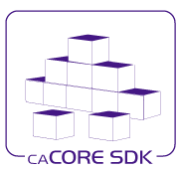
caCORE SDK Integration
Created Data Service Introduce extension for SDK 4.1.1
Upgraded Introduce XMI-based schema generation to leverage SDK 4.1.1
Shared libraries between SDK and caGrid:
Common CQL Processor for SDK and Data Services
Common Testing of caGrid and SDK

Slide 91
Data Services: Federated Query Processor (FQP)
Added configurable query execution parameters to allow control over behavior in the face of failure
Ability to return partial results, specify retries, or fail
Added new results metadata which gets updated during query execution containing:
Overall processing status (waiting, working, done, etc)
Details of each target service (range of data in results, faults, etc)
Support WS-Notification
Client can be notified of changes in execution status for example
Support for delegation via integration with Credential Delegation Service (CDS)
Client can use CDS to delegate to FQP, and request FQP to query data services using the delegated credential
Support for using caGrid Transfer to obtain query results
Performance enhancements, included multi-threaded queries

Slide 92
Introduce Toolkit: Security-related improvements
Created authorization extension framework for plugging in arbitrary authorization components
Migrated Grid Grouper and CSM Authorization to authorization extensions
Created an authorization extension to do “authentication only” (i.e. check that the user presented a credential)
Greater ability for client to control use of credentials
Clients now have a preferAnonymous operation which can be used to override service suggestions
Greater clarity of effect of options in GUI for security settings
Integrated GAARDS UI components to Introduce (e.g. ability to login, request credentials, etc)

Slide 93
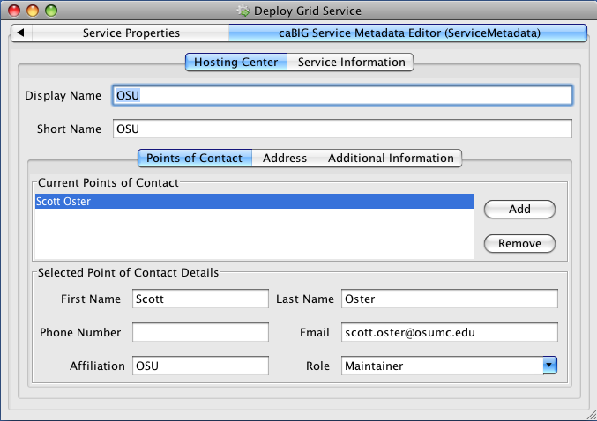
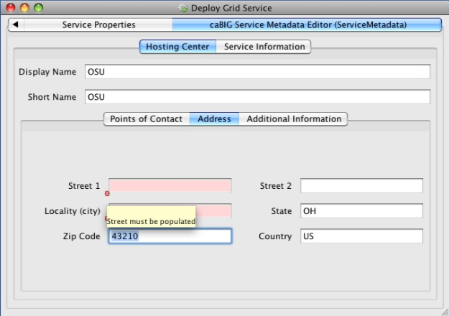
Introduce Toolkit: Other improvements
Added deploy-time validation extension framework
caGrid metadata validator ensures proper metadata is filled out or prevents deployment (e.g. point of contact, host information)
Developed Service Upgrade Support for previous versions
1.1 -> 1.3
1.2 -> 1.3
No Updater for 1.0 -> 1.3

Slide 94
Security: Authentication Enhancements
Addition of Authentication Profiles, adding support for authentication beyond just “username/password”
Support for one-time passwords profile included in this release
Authentication Service refactored to support; Dorian added implementation
Ability to securely discover Trusted Identity Providers
Dorian now maintains authentication service metadata (URL and identity) for its IDPs
Clients can discover Authentication Services for trusted IDPs by asking Dorian or viewing its new metadata exposing this information
GAARDS UI now leverages this

Slide 95
Security: WebSSO Enhancements
Created an Acegi client
Out of the box support for Liferay
Updated to newer CAS versions (server:3.2.2, client:3.1.1)
Implementation of Single Sign-Out
A user logging off of one application will be logged off of all participating in the SSO session
Added support for Authentication Profiles and discovery of Authentication Services via Dorian’s trusted IDP metadata
Created comprehensive integration tests which deploy and test the WebSSO server, sample applications, Dorian, and CDS

Slide 96
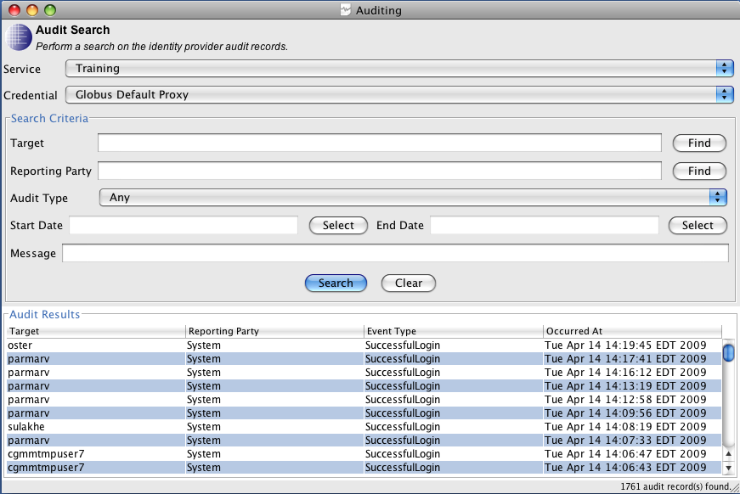
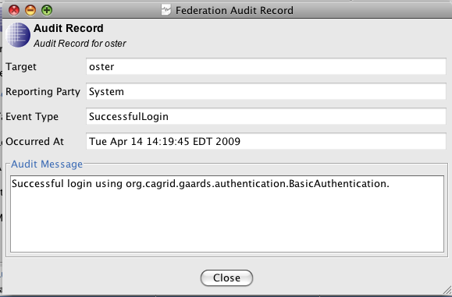
Security: Dorian
Service now leverages Spring for configuration
Implementation of Authentication Profiles and IDP metadata
Move from issuing Proxy Certificates to Short-Term Certificates
Added comprehensive auditing to service and ability to access audit records over the service interface (as an admin)
GAARDS UI support for querying and viewing audit records

Slide 97
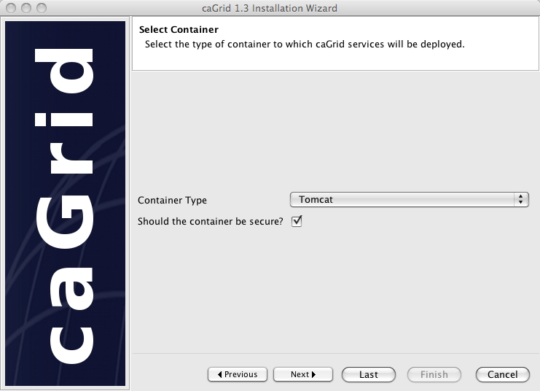
caGrid Installer
Refactored and refocused on desktop deployment (most common pattern)
Does not deploy/configure services anymore
Installs: prerequisites, configures caGrid, and configures containers (current CBIIT technology stack)
Added support for Jboss
Can launch GAARDS UI to request credentials directly during installation
No longer necessary to stop and start installation for secure container configuration
Can easily be used to retarget a container to a new grid (change target grids and install new credentials)
Better support for custom target grids
Other usability improvements such as avoiding re-downloading, setting execute permissions on scripts, minimizing steps, etc

Slide 98
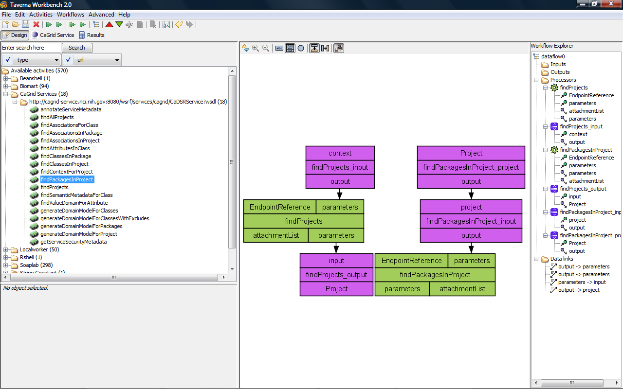
Workflow: Taverna
Added a new service Taverna Workflow Factory Service for executing Scufl (Simple Conceptual Unified Flow language) workflows, which is the language of the Taverna Workbench
Leverages the same service infrastructure as the existing BPEL-based workflow service
Updated client support to Taverna 2

Slide 99
Continuous Innovation
Support for CBIIT FY2008 Future Technology Stack
http://www.cagrid.org/wiki/CBIIT:TechStack:FY2008
Tomcat 5.5.27, JBoss 4.0.5
Expanded Independent Quality Assurance
Significantly improved test coverage
Most thoroughly tested version of caGrid ever
Complete redeployment of the NCI National Grid (all tiers)
Ongoing work toward high-available deployment patterns for caGrid

Slide 100
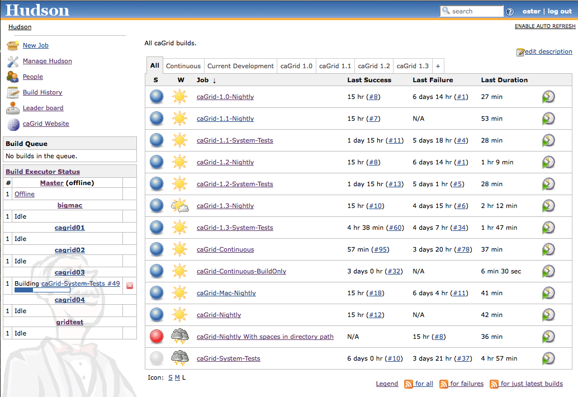
caGrid Quality Dashboard
caGrid automated testing now runs via a Hudson installation with a multi-platform build farm
Replaces previous more custom CruiseControl/DART installation
All historical releases are tested on a nightly basis
Current development continuously built and tested on multiple platforms
619 Unit tests
81 Integration/System tests
Detailed reports accessible via http://quality.cagrid.org/

Slide 101
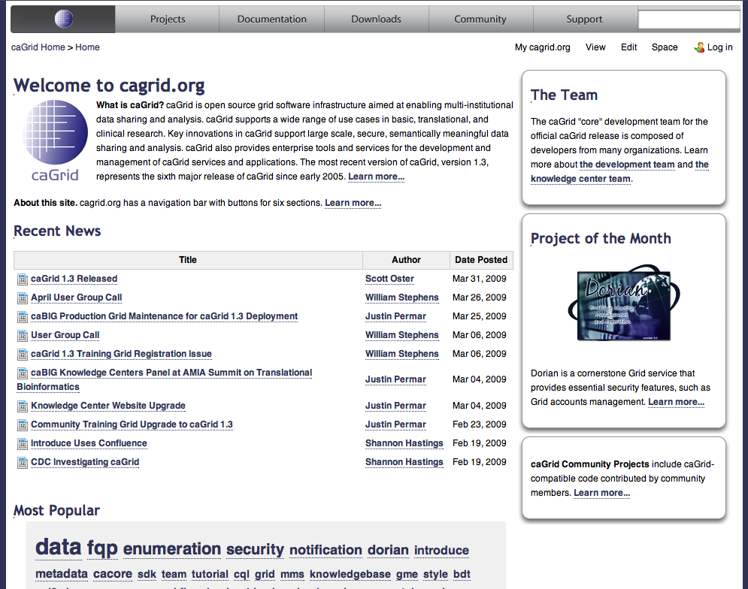
caGrid.org Wiki
caGrid 1.3 is first wiki-only release – no offline documents
caGrid.org wiki will continue to be the source of developer-written product documentation
caGrid KC Wiki will house higher level content supporting deployment, adoption, and integration scenarios
caGrid.org Wiki has been moved from Mediawiki to Conflence and content has been reorganized
Old content may still be accessed at http://mediawiki.cagrid.org

Slide 102
caGrid Support
Getting Support
Knowledgebase / Documentation
Forums / Mailing Lists
Teleconferences
Hands on time with caGrid KC technicians
Support Facilities
ESN Tech Stack
cagrid.org website
Training Grid
http://cagrid.org/display/support/Home

Slide 103
References
caGrid 1.3 Installation Instructions | http://cagrid.org/x/lyRM
caGrid 1.3 Installer | http://gforge.nci.nih.gov/frs/download.php/6357/caGrid-installer-1.3.zip
caGrid 1.3 Source Code | http://gforge.nci.nih.gov/frs/download.php/6354/caGrid-1.3.zip
caGrid 1.3 Documentation | http://cagrid.org/x/5YEX
caGrid 1.3 API Specifications | http://software.cagrid.org/caGrid-1.3-javadocs/
caGrid 1.3 Release Notes | https://gforge.nci.nih.gov/frs/shownotes.php?release_id=3288

